Slide 1

Ensemble learning
Xu Shihao
Data: 2019.02.22
Xu Shihao
xush0019@e.ntu.edu.sg
School of Electrical and Electronic Engineering
Nanyang Technological University Singapore

Slide 2
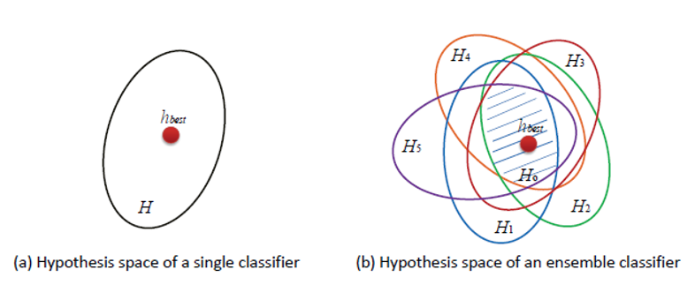
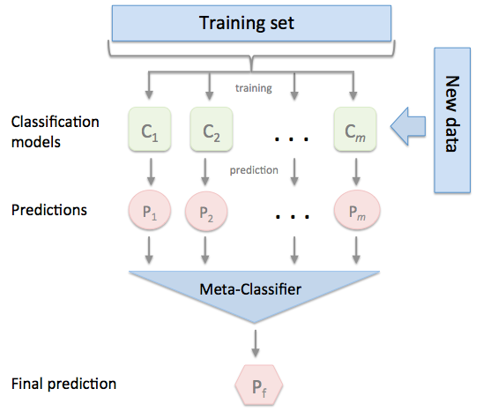
What?
Ensemble learning helps improve machine learning results by combining several models.

Slide 3
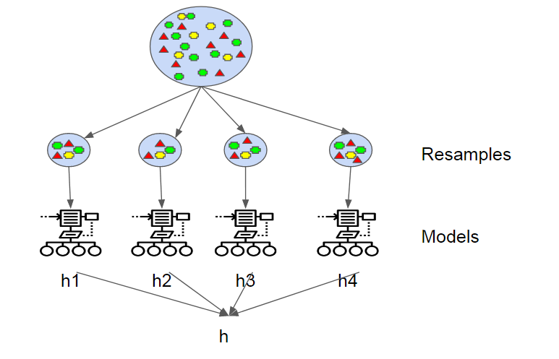
What?
Ensemble learning helps improve machine learning results by combining several models.
Bagging (BaggingClassifier)
Reference tutorial:
https://towardsdatascience.com/ensemble-learning-in-machine-learning-getting-started-4ed85eb38e00
https://blog.statsbot.co/ensemble-learning-d1dcd548e936

Slide 4
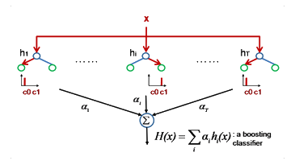
What?
Ensemble learning helps improve machine learning results by combining several models.
Boosting (Adaboost, Gradient boosting, XGBoost)
Reference tutorial:
https://towardsdatascience.com/ensemble-learning-in-machine-learning-getting-started-4ed85eb38e00
https://blog.statsbot.co/ensemble-learning-d1dcd548e936

Slide 5
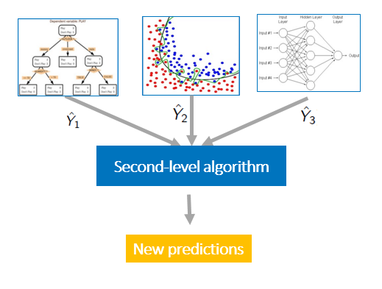
What?
Ensemble learning helps improve machine learning results by combining several models.
Stacking/Voting
Reference tutorial:
https://towardsdatascience.com/ensemble-learning-in-machine-learning-getting-started-4ed85eb38e00
https://blog.statsbot.co/ensemble-learning-d1dcd548e936

Slide 6
Structure of the ensemble learning code

Slide 7



System Pipeline
openSMILE features
Label: Types of people
Schizophrenic patients
Depressive patients
Healthy
SVM
DisVoice features
Logistic Regression
Non-verbal features
Conversational features
Weighted soft voting
AdaBoost
LIWC features
Gradient Boosting
Classification
Diction features
Random Forest
LDA features
Verbal Features
Doc2Vec features

Slide 8
System Pipeline
Single feature set & Single classifier:
Classifier 1
Training Data
Feature Extraction
Standardization and Over-Sampling
Prediction
Standardization
Feature Extraction
Testing Data

Slide 9
System Pipeline
Single feature set & Single classifier:
(with cv grid search)
Classifier 1
Feature Selection & Parameter Tuning
10-fold CV GridSearch
Training Data
Feature Extraction
Standardization and Over-Sampling
Prediction
Standardization
Feature Extraction
Testing Data

Slide 10

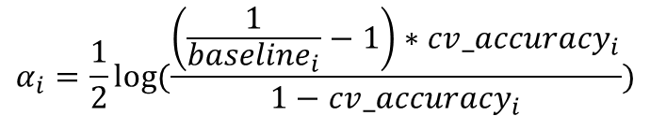




Classification method
Single feature set & multiple classifiers:
Prediction scores
Classifier 1
Feature Selection & Parameter Tuning
10-fold CV GridSearch
Standardization and Over-Sampling
Classifier 2
Feature Selection & Parameter Tuning
Weighted Soft
Voting
Training Data
Feature Extraction
Prediction
…
weight each classifier:
$$α_{i}=\frac{1}{2}log⁡(\frac{\left(\frac{1}{{baseline}_{i}}−1\right)∗{cv_accuracy}_{i}}{1−{cv_accuracy}_{i}})$$
Classifier 5
Feature Selection & Parameter Tuning
$$α_{i}$$
$${baseline}_{i}$$
Standardization
$$0$$
$$1$$
$${cv_accuracy}_{i}$$
Feature Extraction
Testing Data
10

Slide 11
Classification method
multiple feature sets & multiple classifiers:
10-fold CV GridSearch
Feature Set 1
Standardization and Over-Sampling
Classifiers
10-fold CV GridSearch
Standardization and Over-Sampling
Classifiers
Weighted Soft Voting
Training Data
Feature Extraction
Feature Set 2
Prediction
10-fold CV GridSearch
Feature Set 3
Standardization and Over-Sampling
Classifiers
Standardization
Feature Extraction
Testing Data
11

Slide 12
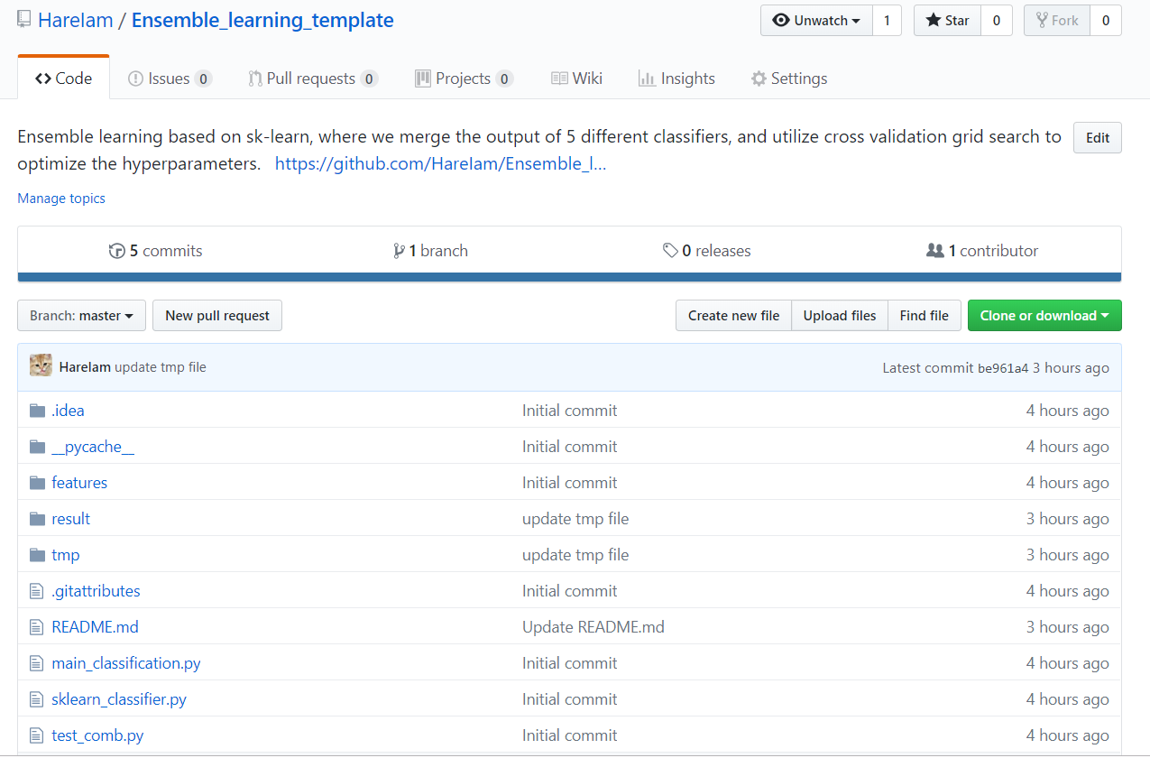
Code Download
https://github.com/HareIam/Ensemble_learning_template
Noted：
Python 3.x
scikit-learn == 0.19.2
imbalance-learn == 0.3.3
numpy==1.14.5

Slide 13
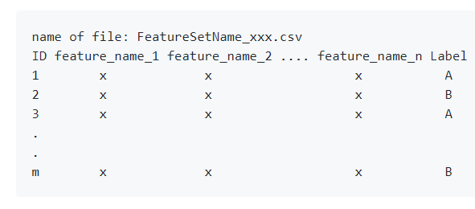
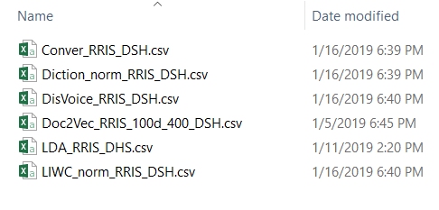
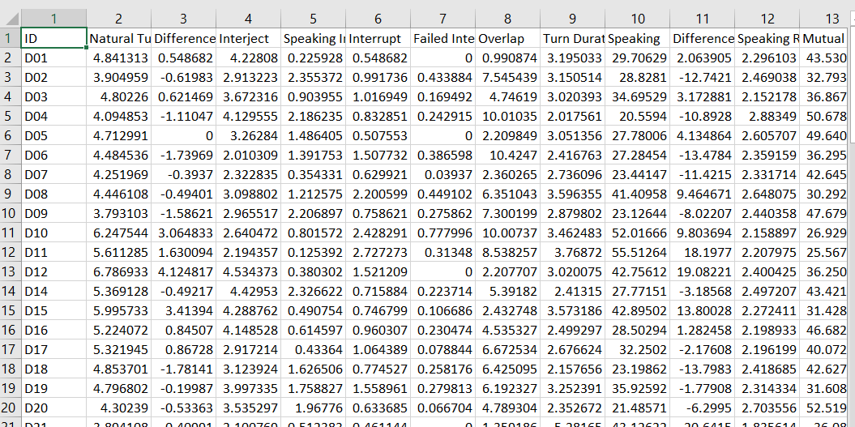
Input
Name your feature csv files as FeatureSetName_xxx.csv
Noted: This code only considers the samples exist in all feature set.

Slide 14
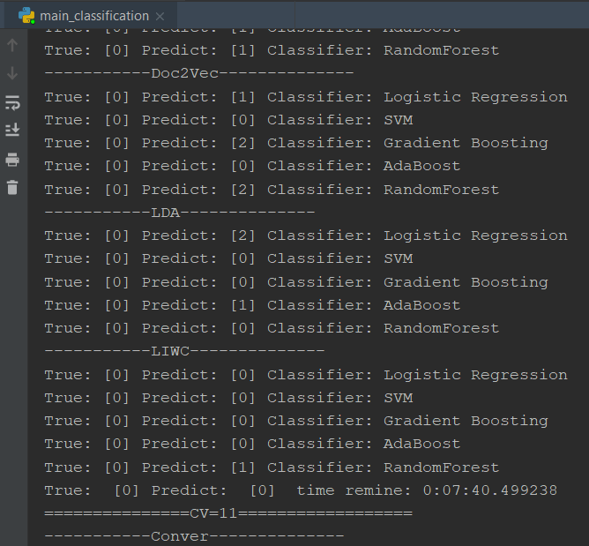
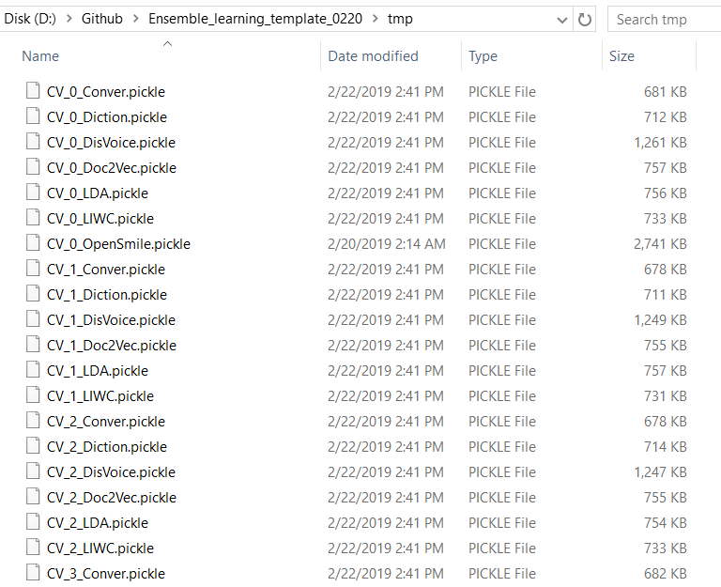
Output of main_classification.py
Output predictions of each classifier of each feature set
Save all predictions and scores in each cross-validation loop in ./tmp

Slide 15
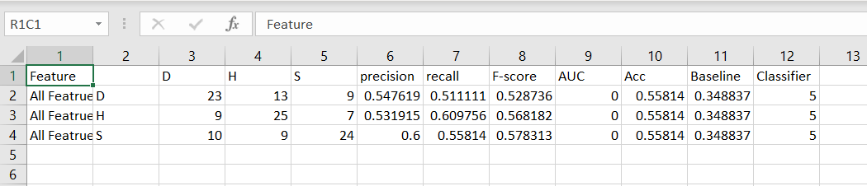
Output of main_classification.py
Output predictions of each classifier of each feature set
Save all predictions and scores in each cross-validation loop in ./tmp
Save final classification results in ./result/Audio_clf_result.csv
Accuracy of
Majority vote
Confusion matrix
Classification
metrics
Classification
accuracy

Slide 16
Output of main_classification.py
Output predictions of each classifier of each feature set
Save all predictions and scores in each cross-validation loop in ./tmp
Save final classification results in ./result/Audio_clf_result.csv
Save Important features in ./result/Important features.csv
Returns the percentage of the number of times each feature was selected

Slide 17
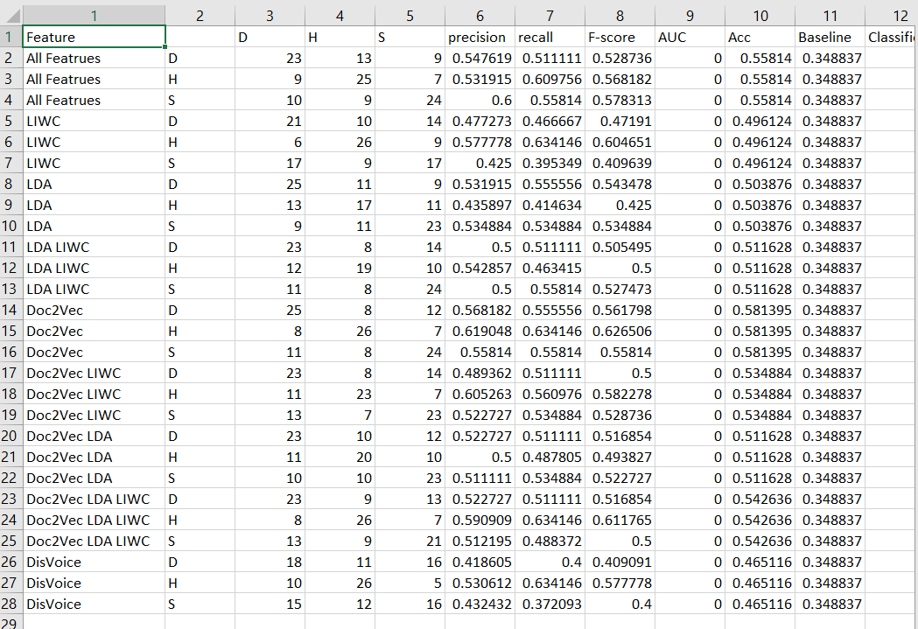
Output of test_comb.py
The classification results that used different combinations of feature sets
The results are in ./result/Audio_clf_results.csv

